Slide 1
Policy-Sealed Data:
A New Abstraction for Building Trusted Cloud Services
Nuno Santos¹, Rodrigo Rodrigues², Krishna P. Gummadi¹, Stefan Saroiu³
MPI-SWS¹, CITI / Universidade Nova Lisboa², Microsoft Research³

Slide 2


Managing the Cloud is Complex & Error-Prone
Is my data
properly managed?
Data
Customer
Cloud Software
Administrator
Cloud software admins. can compromise customers’ data
Cloud Provider
Notes:
In today’s cloud computing model, customers are very keen on having their data properly managed by the cloud provider
However, managing the cloud is complex and error prone, and despite the best efforts of the cloud provider, customer data might be at riskl due to mismanagement threats
In particular, cloud software admins acting negligently or unethically could easily access and compromise customers’ data

Slide 3
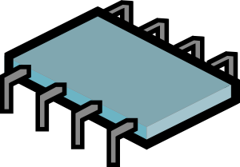
Trusted Computing Can Help Mitigate Threats
Newer hypervisors can offer protection from SW admins.
  e.g., nested virtualization: CloudVisor [SOSP’11], Credo [MSR-TR]
Trusted computing can attest cloud node runs
“correct” hypervisor
  Trusted Platform Module (TPM)
Attest
Customer
Customer
VM
Hypervisor
HW
TPM
Cloud Node
But, TPMs alone ill-suited for the cloud
Cloud Provider
Notes:
Trusted computing has been recently proposed to help address these threats
In this approach, the cloud service is redesigned as to provide confidentiality protection of the customer computations and data hosted on the nodes
This property is achieved in two steps
First step is to deploy a secure hypervisor that can offer protection from the software administrators
Examples are CloudVisor or Credo, which prevent inspection or interference w/ the state of VMs allow an admin to manage the resources of VMs while
Second step is to give customers the guarantee that the binary of secure hypervisor hasn’t been tampered with before boot: this ensures that the nodes are trustworthy and it is safe to ship the data
To provide this guarantee, cloud providers could deploy commodity Trusted Computing Modules (TPM) on the nodes and let customers run remote attestation protocol
But, TPMs alone are ill-suited for the cloud: TPMs have been developed for desktop platforms and not for multi-node multi-tenant cloud platforms

Slide 4
TPMs Alone Are Ill-Suited for the Cloud
Stifle VM and data migration across cloud nodes
  TPMs root-of-trust not transferable from one node to another
Cloud providers hesitant to reveal low-level cloud details
  TPMs abstractions can reveal node’s identity and details of the node’s entire software stack
Commodity TPMs can hinder the cloud’s ability to scale
  TPMs’ poor performance may introduce bottlenecks
Notes:
- TPMs are ill suited for the cloud for three main reasons
first, they could stifle…
- TPMs root-of-trust is strongly coupled to one single node and not transferable from one node to another
- For example, using TPM sealed storage would bind the data to a single node
- second, cloud providers are hesitant to reveal node’s identities and low-level details about software configurations
- remote attestation of nodes publicly reveals unique node identities & TSP hashes of the software booting on the nodes
- this information could be leverage by hackers to spot vulnerabilities in the cloud infrastructure or exploited by cloud provider competitors for business advantage
third, commodity TPMs are very inefficient
In particular, it could create scalability bottlenecks, or open new avenues for DoS
Our goal is to overcome these limitations and help cloud providers make use of TPMs in the cloud

Slide 5
Our Contributions
Policy-sealed data abstraction
  Data is handled only by nodes satisfying customer-chosen policy
  Examples:
    Handle data only by nodes running CloudVisor
    Handle data only by nodes located in the EU
Use attribute-based encryption (CP-ABE) to implement abstraction efficiently
  Binds policies and node attributes to node configurations
  Ciphertext-Policy Attribute-Based Encryption [Bethencourt07]
Excalibur incorporates both contributions
Notes:
To meet this goal, we make two main contributions
First, we propose an abstraction for building TC services called policy-sealed data
This abstraction offers the guarantee that data can only be accessible by nodes whose configurations meet a policy specified by the customer
This policy may refer to software or hardware attributes
For example…
Second, use novel cryptography (i.e., attribute-based encryption) to implement abstraction efficiently
Efficiently bind the high level node attributes and customer defined policies to TPM identities and hashes
Both contributions integrate the design of Excalibur, a system that enables cloud provides to leverage TPMs for building trusted cloud services

Slide 6
Excalibur Addresses TPM Limitations in Cloud
Enables flexible data migration across cloud nodes
  Customer data accessible to any node that satisfies the customer policy
Hides node’s identities and low-level details of the software
  Only high-level attributes are revealed
Masks TPMs’ poor performance
  Enforcing policies does not require direct calls to TPMs
Policy-sealed data
Attribute-based
encryption
Notes:
Excalibur addresses the three main limitations of TPMs in the cloud
First, policy-sealed data abstraction allows data to migrate flexibly in the cloud
It gives customers guarantees that their data can only be accessed by the nodes they trust while
But lets any node whose configuration satisfies the customer policy can retrieve his data
Second, policy-sealed data hides the node identities and the low-level software hashes typically revealed by the TPMs
In this case, only high-level attributes specified by the cloud providers are revealed
This feature allows providers to control how much information they are willing to disclose
Third, attribute-based encryption addresses the TPM inefficiency problem
because policy enforcement w/ CPABE does not require direct access to TPMs
By this, Excalibur can handle the cloud’s high-performance demands

Slide 7
Outline
Introduction
Threat model
Policy-sealed data
Design
  Monitor
  CP-ABE
Evaluation

Slide 8
Threat Model
The attacker can…
The attacker cannot…
configure nodes remotely
  reboot nodes
  install software platform
  access disk
  eavesdrop network
perform physical attacks
  e.g., scrape TPMs to learn its secrets
compromise system’s TCB
  monitor
  secure hypervisor
compromise CP-ABE
Notes:
assume that the attacker has the privileges to configure any node of cloud remotely
thus, the attacker can…
however, we assume the attacker cannot perform physical attacks
E.g., he cannot tamper with TPMs to learn its secrets
This assumption is reasonable because typically hw and sw managed independently by different teams
And the access to hw access restricted
we also assume that the TCB of the system is correct
therefore that the attacker cannot compromise the system’s TCB

Slide 9
Outline
Introduction
Threat model
Policy-sealed data
Design
  Monitor
  CP-ABE
Evaluation

Slide 10
Policy-Sealed Data
Seal
encrypt and bind data to policy
Unseal
decrypt data iff node meets policy
+
Policy-Sealed Data
Seal to:
visor = “secure visor”
Hypervisors
Customer
Secure
Provider
Commodity
Notes:
in defining this abstraction, we wanted to allow customers to restrict which nodes can access their data
but, for the purpose of data mobility, we want to allow any node that meets customers’ requirements to access it
to support this, policy-sealed data is an abstraction that defines two primitives seal / unseal:
- seal takes as input a piece of data and a customer-defined policy and encrypts and binds the data to a policy
- unseal decrypts the resulting envelope iif this operation is executed on a node whose configuration meets the policy
To illustrate how it works consider the following example:
Cloud illustrates two kinds of nodes, each with a different config (blue and yellow)
To ensure that the data can only be accessible to the yellow nodes, the customer specifies a policy accordingly, seals the data (operation shown w/ the black star), and sends it to the cloud
In the cloud, unseal (represented with the white star) will only work on yellow nodes and will fail on blue nodes
If the data or the VM needs to be migrated or stored, the hosting node only re-seal the data with the original policy
Let’s now see what kind of policies are supported

Slide 11
Policy-Sealed Data: Attributes & Policies
Node configurations expressed as set of attributes
Attributes mapped to nodes’ identities and software config
  node id → hardware attributes
  software config → software attributes
Customers select trusted node configurations in policies
  Logic expressions over attributes
Node Attributes
service : “EC2”
hypervz : “CloudVisor”
version : “1”
country : “Germany”
zone : “z1”
Data Policy
service = “EC2”
and
hypervz = “CloudVisor”
and
version >= “1”
and
(country = “Germany”
or
country = “UK”)
Notes:
In policy-sealed data, the configuration of nodes is expressed in terms of attributes, which are basically key-value pairs
These attributes then map to a specific TPM id or TPM hash
When mapped to TPM hashes, attributes can express software features, e.g., the service name and the model and version of the hypervisor
When mapped to TPM ids, attributes can express hardware features, e.g., the country or the zone where the cloud node is placed
The specification and meaning of attributes is entirely defined by the cloud provider
Policies:
Customers can then select the configurations they trust by specifying a policy over the attributes supported by the cloud provider
A policy is a logic expression over these attributes, for example it can bind the data to nodes allocated to the EC2 service, running CloudVisor version greater than 1, located in germany or in the eu
This feature gives a lot of flexibility for customers to specify their preferences

Slide 12
Outline
Introduction
Threat model
Policy-sealed data
Design
  Monitor
  CP-ABE
Evaluation

Slide 13
Excalibur Architecture
Check node configurations
  Monitor attests nodes in background
Scalable policy enforcement
  CP-ABE operations at client-side lib
+
Customer
Policy-Sealed Data
seal
attest &
send
credential
unseal
Monitor
Datacenter
Notes:
Excalibur is a system that overcomes the limitations of TPMs in the cloud
It exposes the policy-sealed data abstraction which allows customers to restrict which nodes they trust to access their data by specifying a policy
Excalibur comprises two main components: a client-side library and a monitor
The library exposes an interface that offers the policy-sealed data for customers and nodes
Customers can use it to bind their data to a policy, and nodes to request access to the data
The monitor is a central component that operates in background and coordinates the enforcement of these policies
This coordination is done in two steps:
1st, it checks the configurations of each node by running a remote attestation protocol and sending a credential to the nodes
This credential is a CP-ABE key that embeds the configuration attributes of the node
2nd, policies can then be enforced entirely at the client-side due to the properties of CP-ABE

Slide 14
Excalibur Mediates TPM Access w/ Monitor
Monitor goals:
Track node ids + TPM-based attestations
  Hides low-level details from users
Track nodes’ attributes that cannot be attested via today’s TPMs
  e.g., nodes’ locations (EU vs. US)
Form the cloud’s root of trust
  Customers only need to attest the monitor’s software configuration
Customer
TPM
Cloud Node
Monitor
Notes:
At a high-level, the monitor is responsible for mediating the access to the cloud nodes’ TPMs and coordinating the enforcement of policy-sealed data
It plays three main roles
First, it keeps track of the node identities and of TPM-based attestations as to hide the low-level details from users
Second, it keeps track of the node configurations expressed in the form of attributes, which cannot be attested via today’s TPMs
For example the location, etc.
In order to map these high-level attributes to node identities and hashes of software platforms, the monitor obtains this information from special certificates
These special certificates are emitted by trusted third parties which are responsible for assuring the correctness of the mapping (e.g., that a particular node with identity X is located in country Y)
Third, it constitutes the root of trust of the entire cloud
Instead of attesting the cloud nodes, customers only need to attest the monitor to ensure that policy-sealed data is enforced in the cloud
This is necessary to ensure that the monitor hasn’t been tampered with before boot
The techniques for scaling the monitor can be found in our paper
Next we show how attribute-based encryption allows for the efficient enforcement of policies in the cloud

Slide 15
Attribute-based Encryption Is Key to Scalability
Customers seal data to a policy with a CP-ABE encryption key
Once each node attests its configuration, monitor hands CP-ABE decryption key
  Ciphertext-Policy Attribute-Based Encryption [Bethencourt07]
Encryption
Key
Seal ( , Data, Policy )
Decryption
Key
Master
Key
Policy-Sealed
Data
Unseal ( , ) ) → Data
Attributes
Monitor
Node
Notes:
To enforce the customer-defined policies, we use ciphertext-policy attribute-based encryption, or CP-ABE for short
Essentially, customers use a CP-ABE encryption key for sealing data
To unseal the data successfully, nodes need to own a CP-ABE decryption key embedding a set of attributes that satisfies the policy
It works as follows:
In the setup phase, the monitor generates a master key and an encryption key, which is revealed to customers; the master key is kept secret
After the attestation of each node, the monitor sends a decryption key that contains attributes according to the configuration of the node
Customers can then seal the data w/ encryption key, and nodes unseal with the decryption key
Benefits:
With CPABE, all seal / unseal operations take place at the client side thereby avoiding the monitor to become a bottleneck
Furthermore, CPABE facilitates key management because only a single decryption key needs to be generated per unique node configuration

Slide 16
Outline
Introduction
Threat model
Policy-sealed data
Design
  Monitor
  CP-ABE
Evaluation

Slide 17
Methodology
Two questions:
  What is the overhead of policy-sealed data?
  Is the monitor a scalability bottleneck?
Implemented cloud service akin to EC2
  Based on Eucalyptus / Xen cloud platform
  Supports location attribute
  Interposed seal / unseal in VM management operations
Testbed: single monitor and five nodes
  Intel Xeon, 2.83Ghz 8-core CPU, 1.6 GB RAM, TPM v1.2
Notes:
In this talk we try two answer two questions:…
To evaluate the system we built several benchmarks and implemented a cloud service akin to EC2
This service supports the location attribute
And it is based on Eucalyptus / Xen cloud platform, which we extended to secure all the VM operations using Excalibur
Thus, whenever the VM migrates or is suspended we have to seal / unseal its state
We evaluated our prototype on a testbed comprising a single monitor and multiple nodes

Slide 18
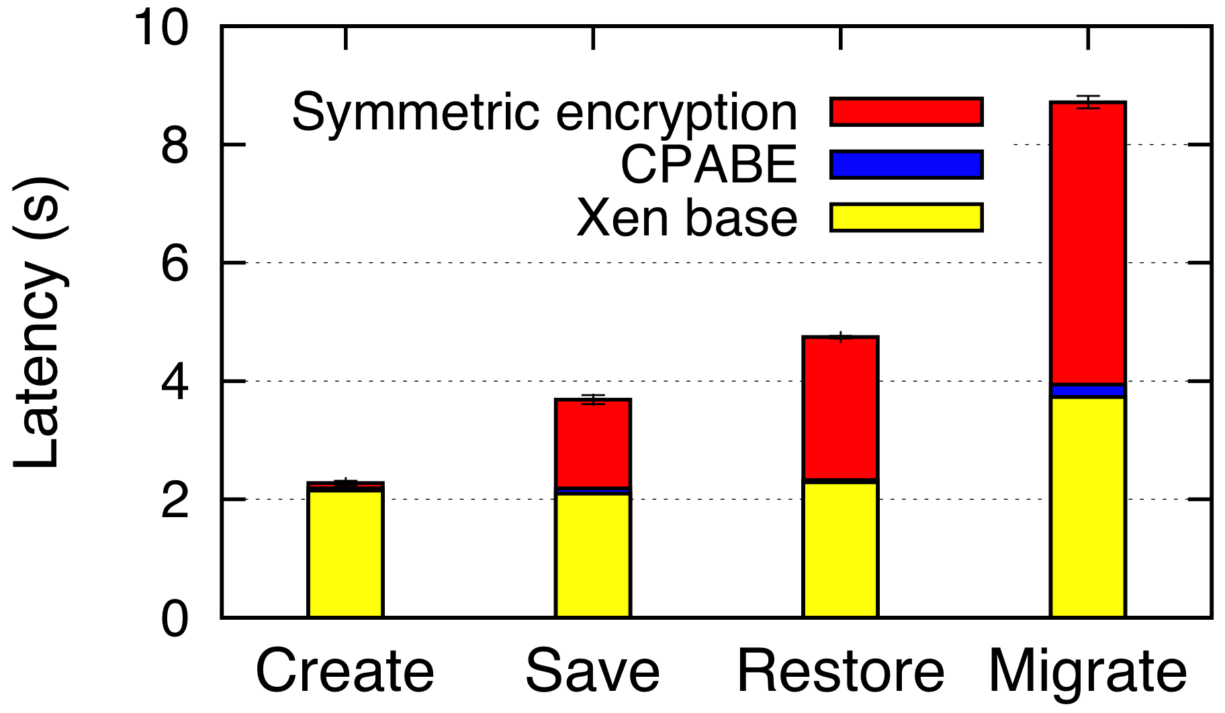
What Is the Overhead of Seal / Unseal?
Overhead of CP-ABE in Eucalyptus / Xen platform
  CP-ABE’s overhead could be significant
  However, VM operations are infrequent
Notes:
To have an idea of the performance of our system on a real service,
we plot the time of the VM management operations of our modified cloud service
We show the four main operations for creation, save, restore, and migrate
Each bar has three basic components:
the yellow is the baseline tiime that Xen takes to perform the operation
the read corresponds to encrypting the VM state using symmetric encryption,
the blue the overhead introduced by CPABE due to seal / unseal operations
We can see that CPABE introduces overhead, but which is infrequent since it takes place once per VM management operation
No hardware acceleration

Slide 19
Is the Monitor a Scalability Bottleneck?
Monitor can attest a large number of nodes
  Max throughput: 630 attestation-verifications/sec
  E.g., 10K node cluster attests in ~15 seconds
Monitor can serve many attestation requests from customers
  Max throughput: 4800 attestation-requests/sec
  Increases throughput of standard TPM attestation
    Batches multiple attestation requests into single TPM call
  Speedup orders of magnitude over standard TPM attestation
Notes:
To evaluate how much load the monitor can withstand, there are two main aspects we need to measure:
how many nodes can the monitor attest when checking the configuration of nodes?
How many attestations requested by the customers can a single monitor serve?
Our evaluation shows that the monitor can attest a large number of nodes
For example, attesting a 10K node cluster would take approx 15 seconds (assuming that all the nodes boot at the same time)
In addition, a single monitor can serve a large number of attestations by customers
In standard TPM attestation protocols, the throughput would be very low because TPMs don’t support concurrent attestation requests
To scale this, we have incorporated a batch attestation mechanism that allow us to get a speedup of several orders of magnitude over the standard TPM’s serial attestation protocols
The results are very good

Slide 20
Conclusions
Excalibur overcomes TPM’s limitations in the cloud
Policy-sealed data: new trusted computing primitive
  Flexible sealed storage
  Reduce overexposure
CP-ABE makes Excalibur scale
  Masks low performance of TPMs
Evaluation indicates that the system is practical
Notes:
In conclusion, I’ve introduced Excalibur, a system that enables cloud providers to build trusted cloud services while addressing the limitations of TPMs in the cloud
Excalibur provides a policy-sealed data abstraction which
Enables flexible storage and migration of data within the cloud
Reduces the risk of overexposure of the cloud infrastructure to the outside
Excalibur relies on a centralized monitor that masks the low performance of TPMs
And scales massively due to the use of CP-ABE
Our evaluation shows that our system meets the performance requirements for practical use

